Slide 1
Programming Methodology for Finance
Shiyu Zhou
http://www.ece.rutgers.edu/~szhou/503/503.html

Slide 2
1.1 Introduction
Software
  Instructions to command computer to perform actions and make decisions
Hardware
Standardized version of C++
  United States
    American National Standards Institute (ANSI)
  Worldwide
    International Organization for Standardization (ISO)
Structured programming
Object-oriented programming

Slide 3
1.2 What is a Computer?
Computer
  Device capable of performing computations and making logical decisions
Computer programs
  Sets of instructions that control computer’s processing of data
Hardware
  Various devices comprising computer
    Keyboard, screen, mouse, disks, memory, CD-ROM, processing units, …
Software
  Programs that run on computer

Slide 4
1.3 Computer Organization
Six logical units of computer
  Input unit
    “Receiving” section
    Obtains information from input devices
      Keyboard, mouse, microphone, scanner, networks, …
  Output unit
    “Shipping” section
    Takes information processed by computer
    Places information on output devices
      Screen, printer, networks, …
      Information used to control other devices

Slide 5
1.3 Computer Organization
Six logical units of computer
  Memory unit
    Rapid access, relatively low capacity “warehouse” section
    Retains information from input unit
      Immediately available for processing
    Retains processed information
      Until placed on output devices
    Memory, primary memory
  Arithmetic and logic unit (ALU)
    “Manufacturing” section
    Performs arithmetic calculations and logic decisions

Slide 6
1.3 Computer Organization
Six logical units of computer
  Central processing unit (CPU)
    “Administrative” section
    Supervises and coordinates other sections of computer
  Secondary storage unit
    Long-term, high-capacity “warehouse” section
    Storage
      Inactive programs or data
    Secondary storage devices
      Disks
    Longer to access than primary memory
    Less expensive per unit than primary memory

Slide 7
1.6 Machine Languages, Assembly Languages, and High-level Languages
Three types of computer languages
  Machine language
    Only language computer directly understands
    “Natural language” of computer
    Defined by hardware design
      Machine-dependent
    Generally consist of strings of numbers
      Ultimately 0s and 1s
    Instruct computers to perform elementary operations
      One at a time
    Cumbersome for humans
    Example:
      +1300042774
      +1400593419
      +1200274027

Slide 8
1.6 Machine Languages, Assembly Languages, and High-level Languages
Three types of computer languages
  Assembly language
    English-like abbreviations representing elementary computer operations
    Clearer to humans
    Incomprehensible to computers
      Translator programs (assemblers)
        Convert to machine language
    Example:
      LOAD BASEPAY
      ADD OVERPAY
      STORE GROSSPAY

Slide 9
1.6 Machine Languages, Assembly Languages, and High-level Languages
Three types of computer languages
  High-level languages
    Similar to everyday English, use common mathematical notations
    Single statements accomplish substantial tasks
      Assembly language requires many instructions to accomplish simple tasks
    Translator programs (compilers)
      Convert to machine language
    Interpreter programs
      Directly execute high-level language programs
    Example:
      grossPay = basePay + overTimePay

Slide 10
1.7 History of C and C++
History of C
  Evolved from two other programming languages
    BCPL and B
      “Typeless” languages
  Dennis Ritchie (Bell Laboratories)
    Added data typing, other features
  Development language of UNIX
  Hardware independent
    Portable programs
  1989: ANSI standard
  1990: ANSI and ISO standard published
    ANSI/ISO 9899: 1990

Slide 11
1.7 History of C and C++
History of C++
  Extension of C
  Early 1980s: Bjarne Stroustrup (Bell Laboratories)
  “Spruces up” C
  Provides capabilities for object-oriented programming
    Objects: reusable software components
      Model items in real world
    Object-oriented programs
      Easy to understand, correct and modify
  Hybrid language
    C-like style
    Object-oriented style
    Both

Slide 12
1.8 C++ Standard Library
C++ programs
  Built from pieces called classes and functions
C++ standard library
  Rich collections of existing classes and functions
“Building block approach” to creating programs
  “Software reuse”

Slide 13
1.12 Structured Programming
Structured programming (1960s)
  Disciplined approach to writing programs
  Clear, easy to test and debug, and easy to modify
Pascal
  1971: Niklaus Wirth
Ada
  1970s - early 1980s: US Department of Defense (DoD)
  Multitasking
    Programmer can specify many activities to run in parallel

Slide 14
1.13 The Key Software Trend: Object Technology
Objects
  Reusable software components that model real world items
  Meaningful software units
    Date objects, time objects, paycheck objects, invoice objects, audio objects, video objects, file objects, record objects, etc.
    Any noun can be represented as an object
  More understandable, better organized and easier to maintain than procedural programming
  Favor modularity
    Software reuse
      Libraries
        MFC (Microsoft Foundation Classes)
        Rogue Wave

Slide 15
1.14 Basics of a Typical C++ Environment
C++ systems
  Program-development environment
  Language
  C++ Standard Library

Slide 16
1.14 Basics of a Typical C++ Environment
Phases of C++ Programs:
  Edit
  Preprocess
  Compile
  Link
  Load
  Execute
Program is created in
the editor and stored
on disk.
Editor
Disk
Preprocessor
Disk
Preprocessor program
processes the code.
Compiler creates
object code and stores
it on disk.
Compiler
Disk
Linker links the object
code with the libraries,
creates a.out and
stores it on disk
Linker
Disk
Primary
Memory
Loader
Loader puts program
in memory.
Disk
.
.
.
.
.
.
Primary
Memory
CPU
CPU takes each
instruction and
executes it, possibly
storing new data
values as the program
executes.
.
.
.
.
.
.

Slide 17
1.21 A Simple Program:
Printing a Line of Text
Comments
  Document programs
  Improve program readability
  Ignored by compiler
  Single-line comment
    Begin with //
Preprocessor directives
  Processed by preprocessor before compiling
  Begin with #

Slide 18
1 // Fig. 2.4: fig01_02.cpp
2 // A first program in C++.
3 #include <iostream>
4
5 // function main begins program execution
6 int main()
7 {
8 std::cout << "Welcome to C++!\n";
9
10 return 0; // indicate that program ended successfully
11
12 } // end function main
Single-line comments.
Function main returns an integer value.
Left brace { begins function body.
Preprocessor directive to include input/output stream header file <iostream>.
Function main appears exactly once in every C++ program..
Statements end with a semicolon ;.
Corresponding right brace } ends function body.
Stream insertion operator.
Name cout belongs to namespace std.
Keyword return is one of several means to exit function; value 0 indicates program terminated successfully.
Welcome to C++!

Slide 19
1.21 A Simple Program:
Printing a Line of Text
Standard output stream object
  std::cout
  “Connected” to screen
  <<
    Stream insertion operator
    Value to right (right operand) inserted into output stream
Namespace
  std:: specifies using name that belongs to “namespace” std
  std:: removed through use of using statements
Escape characters
  \
  Indicates “special” character output

Slide 20
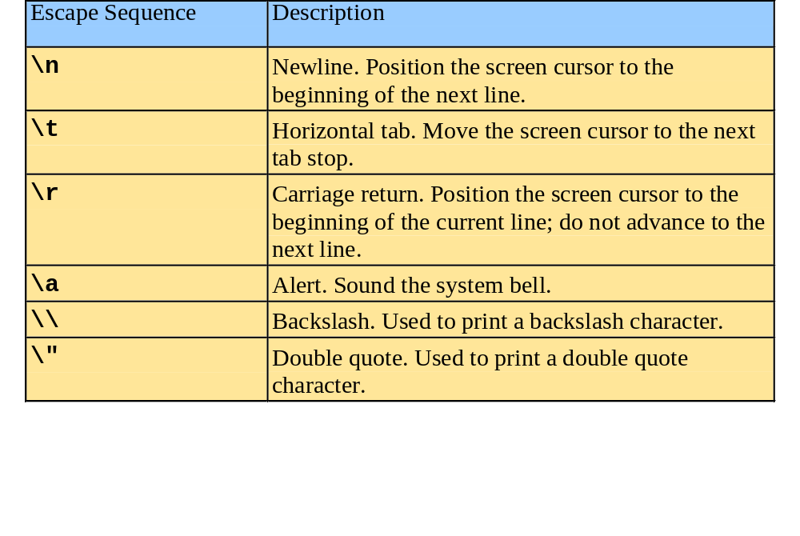
1.21 A Simple Program:
Printing a Line of Text

Slide 21
1 // Fig. 1.4: fig01_04.cpp
2 // Printing a line with multiple statements.
3 #include <iostream>
4
5 // function main begins program execution
6 int main()
7 {
8 std::cout << "Welcome ";
9 std::cout << "to C++!\n";
10
11 return 0; // indicate that program ended successfully
12
13 } // end function main
Multiple stream insertion statements produce one line of output.
Welcome to C++!

Slide 22
1 // Fig. 1.5: fig01_05.cpp
2 // Printing multiple lines with a single statement
3 #include <iostream>
4
5 // function main begins program execution
6 int main()
7 {
8 std::cout << "Welcome\nto\n\nC++!\n";
9
10 return 0; // indicate that program ended successfully
11
12 } // end function main
Using newline characters to print on multiple lines.
Welcome
to
C++!

Slide 23
1.22 Another Simple Program:
Adding Two Integers
Variables
  Location in memory where value can be stored
  Common data types
    int - integer numbers
    char - characters
    double - floating point numbers
  Declare variables with name and data type before use
    int integer1;
    int integer2;
    int sum;
  Can declare several variables of same type in one declaration
    Comma-separated list
    int integer1, integer2, sum;

Slide 24
1.22 Another Simple Program:
Adding Two Integers
Variables
  Variable names
    Valid identifier
      Series of characters (letters, digits, underscores)
      Cannot begin with digit
      Case sensitive

Slide 25
1.22 Another Simple Program:
Adding Two Integers
Input stream object
  >> (stream extraction operator)
    Used with std::cin
    Waits for user to input value, then press Enter (Return) key
    Stores value in variable to right of operator
      Converts value to variable data type
= (assignment operator)
  Assigns value to variable
  Binary operator (two operands)
  Example:
      sum = variable1 + variable2;

Slide 26
fig01_06.cpp
(1 of 1)
1 // Fig. 1.6: fig01_06.cpp
2 // Addition program.
3 #include <iostream>
4
5 // function main begins program execution
6 int main()
7 {
8 int integer1; // first number to be input by user
9 int integer2; // second number to be input by user
10 int sum; // variable in which sum will be stored
11
12 std::cout << "Enter first integer\n"; // prompt
13 std::cin >> integer1; // read an integer
14
15 std::cout << "Enter second integer\n"; // prompt
16 std::cin >> integer2; // read an integer
17
18 sum = integer1 + integer2; // assign result to sum
19
20 std::cout << "Sum is " << sum << std::endl; // print sum
21
22 return 0; // indicate that program ended successfully
23
24 } // end function main
Declare integer variables.
Use stream extraction operator with standard input stream to obtain user input.
Calculations can be performed in output statements: alternative for lines 18 and 20:
std::cout << "Sum is " << integer1 + integer2 << std::endl;
Stream manipulator std::endl outputs a newline, then “flushes output buffer.”
Concatenating, chaining or cascading stream insertion operations.

Slide 27
Enter first integer
45
Enter second integer
72
Sum is 117

Slide 28
Namespaces & using
using statements
  Eliminate use of std:: prefix
  Write cout instead of std::cout

Slide 29
Namespaces
New ANSI standard,
used in the Deitel book
New ANSI standard,
Sometimes used in the
Deitel book, not “recommended”
as good programming
Old version, comptable with C,
Used in the Bronson book
(see also APPENDIX F)
#include <iostream>
int main()
{
std::cout <<"Hello\n";
}
#include <iostream.h>
int main()
{
cout <<"Hello\n";
}
#include <iostream>
using namespace std;
int main()
{
cout <<"Hello\n";
}
#include <iostream>
using std::cout;
int main()
{
cout <<"Hello\n";
}

Slide 30
Data Types
Integral
Floating
Address
Structured

Slide 31
Data Types
char
256 possibilities;
enclosed in single quotes
int
no decimal points
no commas
no special signs ($, ¥, ‰)
Integral
* *

Slide 32
Data Types
Int -- Signed vs. Unsigned
short 65,536 numbers
-32,768 to 32,767
long 4,294,967,296 numbers
± 2,147,483,648
enum ☒
* *

Slide 33
Data Types
Floating point numbers:
Floating point numbers:
signed or unsigned with decimal point
Types: differ in amount of storage space;
varies with machine
▪ float (single precision)
▪ double
▪ long double
* * *

Slide 34
Data Types
Address
pointer ☒
reference ☒
Structured
array ☒
struct
union ☒
class 

Slide 35
Variables
 a place to store information
 contents of a location in memory

 has an address in RAM
 uses a certain number of bytes
 size depends upon the data type
*

Slide 36
Identifiers
Examples:
x num1 num2 name
_row c237 index tax_rate
Not valid:
1num bye[a] tax-rate tax rate
newPos newpos (beware of this!)
* * *

Slide 37
Declaration Statement
A declaration statement associates an
identifier with a data object, a function,
or a data type so that the programmer
can refer to that item by name.

Slide 38
Declaration Statement
Syntax: data-type variable name;
Examples:
int my_age;
int count;
float deposit;
float amount;
float totalpay;
double balance;
char answer2 ;
*

Slide 39
Multiple Declarations
Syntax: data-type var1, var2, var3;
Examples:
int my_age;
int count;
float deposit, amount, totalpay;
double balance;
char answer2 ;
need ,
*

Slide 40
Constants
Literal
typed directly into the program as needed
ex. y = 23.4 pi = 3.1416
can change
Symbolic (Named)
similar to a variable, but cannot be changed after it is initialized
ex. const int CLASS_SIZE = 87;
const double PI = 3.1416;
can NOT
change
* *

Slide 41
Constants
Symbolic (Named)
similar to a variable, but cannot be changed after it is initialized
Syntax
type VAR
int IMAXY
char BLANK
const
const
const
= value;
= 1000;
= ‘ ‘;
* * *

Slide 42
Sample Program
#include<iostream>
using namespace std;
int main(void)
{
double wdth, height;
const int LEN = 5;
wdth = 10.0;
height = 8.5;
cout << “volume = “<< LEN * wdth * height;
}
declarations
constant
assignments
* * *

Slide 43
1.24 Arithmetic
Arithmetic calculations
  *
    Multiplication
  /
    Division
    Integer division truncates remainder
      7 / 5 evaluates to 1
  %
    Modulus operator returns remainder
      7 % 5 evaluates to 2

Slide 44
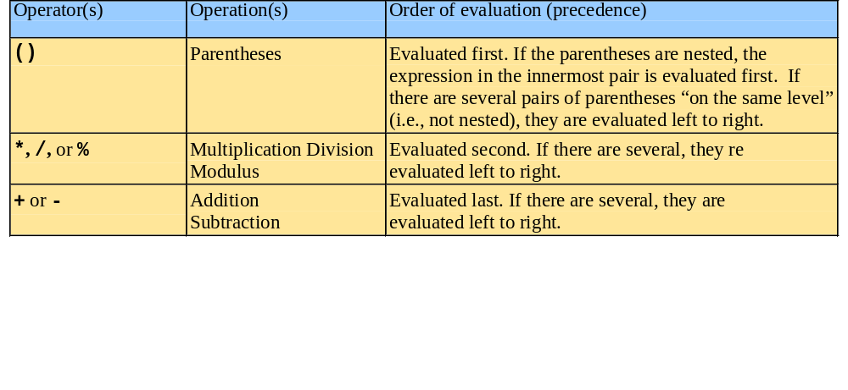
1.24 Arithmetic
Rules of operator precedence
  Operators in parentheses evaluated first
    Nested/embedded parentheses
      Operators in innermost pair first
  Multiplication, division, modulus applied next
    Operators applied from left to right
  Addition, subtraction applied last
    Operators applied from left to right

Slide 45
Modulus
The modulus operator yields the remainder of integer division.
12/3 14/3
4
3 12
12
0
4
3 14
12
2
12%3 14%3
* *

Slide 46
Modulus
The modulus operator yields the remainder of integer division.
18 % 4 is 2 13 % 4 is 1
17 % 3 is 2 35 % 47 is 35
24 % 6 is 0 24 % 4 is 0
4 % 18 is 4 0 % 7 is 0
12 % 2.5 error 6.0 % 6 error
* * *

Slide 47
A Glimpse of
Operator Overloading
Operator overload
Using the same symbol for more than one operation.
type int / type int
9 / 5
operator performs int division
type double / type double
9.0 / 5.0
operator performs
double division
*

Slide 48
Mixed-Mode Expressions
Operator overload
Same operator will behave differently depending upon the operands.
Operands of the same type give results of that type.
In mixed-mode, floating point takes precedence.
* *

Slide 49
Integer Division
int a, b;
a = 8;
b = 3;
cout << “The result is “ << a / b << endl;
The result is 2
8 / 3 is 2 and not 2.6667
The result must be an integer. The result is truncated to 2.
*

Slide 50
Order of Operations
8 + 3 * 4 is ?
Show associativity to clarify.
( 8 + 3 ) * 4 is 44
8 + ( 3 * 4 ) is 20
* *

Slide 51
Order of Operations
Expression Value
10 / 2 * 3
10 % 3 - 4 / 2
5.0 * 2.0 / 4.0 * 2.0
5.0 * 2.0 / (4.0 * 2.0)
5.0 + 2.0 / (4.0 * 2.0)
15
-1
5.0
1.25
5.25
* * * * *

Slide 52
Evaluation Trees
10 / 2 * 3
10 % 3 - 4 / 2
i
i
i
i
i
5.0 * 2.0 / 4.0 * 2.0
5 * 2 / (4.0 * 2.0)
r
i
r
r
r
r
* *

Slide 53
Beware!
C++ requires the asterisk to indicate multiplication.
valid invalid
5*(8+3) 5(8+3)
(x-y)*(x+y) (x-y)(x+y)

Slide 54
Assignment Operator
The assignment operator (=)causes the operand on the left to take on the value to the right side of the statement.
This operator assigns from right to left.
valid invalid
x = 5 5 = x
picard = 6.02
avg_grd = 87.5
*

Slide 55
Assignment Statement
Syntax: variable = expression;
Examples:
quiz1score = 14;
balance = balance + deposit;
The = really means is assigned to (not equals to).
*

Slide 56
Assignment Statement
Examples:
int myage = 33;
int width = 10, length;
double ex1 = 85, ex2 = 73, ex3 = 82;
char ans, key = ‘Q’, ch;
*

Slide 57
#include <iostream>
Using namespace std;
int main()
{
char ch; // this declares a character variable
ch = 'a'; // store the letter a into ch
cout << "The character stored in ch is “ << ch << endl;
ch = 'm'; // now store the letter m into ch
cout << "The character now stored in ch is “<< ch << endl;
return 0;
}
The character stored in ch is a
The character now stored in ch is m

Slide 58
Assignment Operators
+= add then assign
-= subtract then assign
*= multiply then assign
/= divide then assign
X -= 3 ≡ X = X - 3
pay *= 0.35 ≡ pay = pay * 0.35

Slide 59
Assignment Operators
+= ⁻= *= /= %=
Assignment Operators
1. i += 2 i = i + 2
2. r *= 7 r = r * 7
3. j *= (k + 3) j = j * (k + 3)
4. x /= y - 4 x = x /y - 4
5. hour %= 12 hour = hour % 12
6. left -= t_out left = left - t_out
* *

Slide 60
Subtotals
Syntax: variable = variable + new_value;
Examples
year_pay = year_pay + pay;
balance = balance - debit;
counter = counter + 1;
counter += 1;
} ^{same}
*

Slide 61
Increment/Decrement
++ increment
-- decrement
uniary operators
take a single operand
ex. num++, num--
++num, --num

Slide 62
Increment/Decrement
k = k + 1 k = k + 3
k += 1 k += 3
k ++ no equivalent

Slide 63
Increment/Decrement
num = num + 1
num++
i = i + 1
i++
num = num - 1
num--
i = i - 1
i--
num += 1 num ⁻=1
i += 1 i ⁻= 1
* * *
* *

Slide 64
Increment/Decrement
value after execution
k g
1. k = 7;
2. g = 2;
3. k = g;
4. g = g + 1;
7 %#@$
7 2
2 2
2 3
or combine 3 & 4 k = g++
* * *
* *

Slide 65
Increment/Decrement postfix: first use it, then alter value
z = 10;
v = z--;
cout <<v<<‘\t’<<z;
v z
10 9
count = 10;
k = count++;
cout<<k<<‘\t’<<count;
k count
10 11
* * * *

Slide 66
Increment/Decrement
value after execution
k g
1. k = 7;
2. g = 2;
3. g = g + 1;
4. k = g;
7 %#@$
7 2
7 3
3 3
or combine 3 & 4 k = ++g
* * *
* *

Slide 67
Increment/Decrement prefix: first alter value, then use it
z = 10;
v = --z;
cout <<v<<‘\t’<<z;
v z
9 9
count = 10;
k = ++count;
cout<<k<<‘\t’<<count;
k count
11 11
* * * *

Slide 68
Increment/Decrement
output
1 cout << cnt++<<'\n';
2 cout<<cnt<<'\n';
int cnt = 10, guess = 11;
10 // print then inc
11
* * *
* * *

Slide 69
Increment/Decrement
output
1 cout << ++cnt<<'\n';
2 cout<<cnt<<'\n';
int cnt = 10, guess = 11;
11 // inc then print
11
* * *
* * *

Slide 70
Increment/Decrement
int j = 5;
a) cout << j++
b) cout << ++j
c) cout << (j += 14)
d) cout << (j /= 10)
e) cout << (j *= 10)
f) cout << (j ⁻= 6)
g) cout << (j = 5) + j
h) cout << (j == 5) + j
a) 5
b) 7
c) 21
d) 2
e) 20
f) 14
g) 10
h) 6
* * * *
* * * *

Slide 71
cin
  cin >> my_num;
  The keyboard entry is stored into a local
  variable called my_num.
  Read as: “get from the terminal and put into my_num”.

Slide 72
cin
(concatenation)
Syntax: cin >> var1;
cin >> var1 >> var2 >> ...
cin >> first >> last >> my_num;
cin >> qz1 >> qz2 >> qz3 >> qz4;
*

Slide 73
cin & cout
cout cin
<< >>
insertion extraction
“put to” “get from”
whitespace characters ignored

Slide 74
cin Example 1
  int num1, num2, num3;
  double average;
  cout << "Enter three integer numbers: ";
  cin >> num1 >> num2 >> num3;
  average = (num1 + num2 + num3) / 3.0;
  cout << "The average is " << average;
  cout << '\n';

Slide 75
1.23 Memory Concepts
Variable names
  Correspond to actual locations in computer's memory
  Every variable has name, type, size and value
  When new value placed into variable, overwrites previous value
  Reading variables from memory nondestructive

Slide 76
1.23 Memory Concepts
integer1
45
std::cin >> integer1;
  Assume user entered 45
std::cin >> integer2;
  Assume user entered 72
sum = integer1 + integer2;
integer1
45
integer2
72
integer1
45
integer2
72
sum
117

Slide 77
RAM
Address of the memory location
0xa5
9
0xa6
7
0xa7
int x = 9;
int y = 7;

Slide 78
How many bytes?
#include <iostream>
int main ()
{ // the columns below are just for showing on one screen
char ch; float num4; unsigned int num3;
int num1; double num5;
long int num2; long num6;
std::cout <<"\nBytes of storage used by a character:\t\t\t " <<sizeof(ch)
<<"\nBytes used by integer:\t\t\t " <<sizeof(num1)
<<"\nBytes used by long integer:\t\t " <<sizeof(num2)
<<"\nBytes used by unsigned integer:\t\t " <<sizeof(num3)
<<"\nBytes used by floating point number:\t " <<sizeof(num4)
<<"\nBytes used by double floating point:\t " <<sizeof(num5)
<<"\nBytes used by long floating point:\t\t "
<<sizeof(num6)<<‘\n’;
}

Slide 79
How many bytes?
Bytes of storage used by a character: 1
Bytes used by an integer: 4
Bytes used by a long integer: 4
Bytes used by an unsigned integer: 4
Bytes used by a floating point number: 4
Bytes used by a double floating point: 8
Bytes used by a long floating point: 4

Slide 80
REVIEW OF BASIC C++: What does this program do?
int main()
{
int x, y, z;
int mystery;
cout << “please enter three numbers\n”;
cin >> x >> y >> z;
mystery = x + y + z;
mystery /=3;
cout << “mystery is “ << mystery << endl;
return 0;
}

Slide 81
Reserved/Keywords
Words that have special meanings in the language. They must be used only for their specified purpose. Using them for any other purpose will result in a error.
e.g. cout do if switch
cin while else return
*

Slide 82
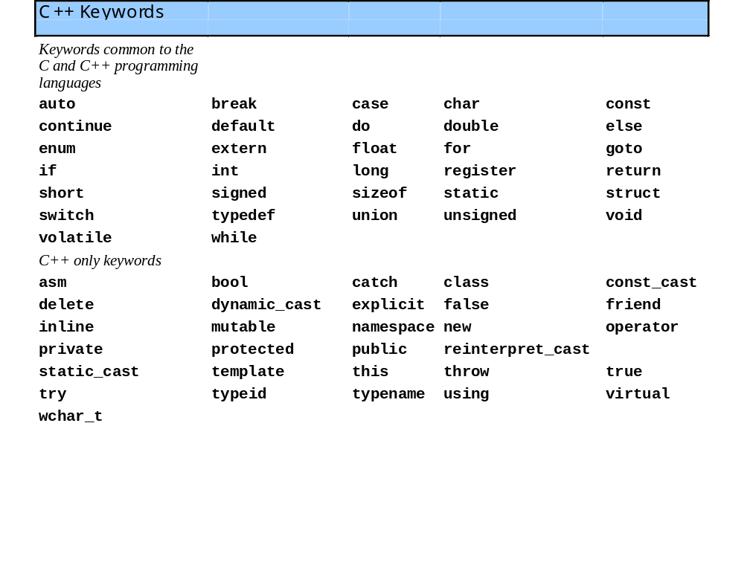

Slide 83
Reserved Words
C++ is case-sensitive.
Thus:
cout COUT Cout cOut
all have different meanings.
The
reserved words are all in lowercase.
* *

Slide 84
Statements
A statement controls the sequence of execution, evaluates an expression, or does nothing, and ends with a semicolon.

Slide 85
Statements
{
cout <<"A fraction: "<<5/8 <<endl;
cout <<"Big # : "<< 7000*7000<<endl;
cout <<8 + 5 <<" is the sum of 8 & 5\n";
cout << “Hello world”;
}
There are 5 statements.

Slide 86
Comments
These are important parts of a program.
Two types
//
/* */ or /*
*/
* *

Slide 87
Comments
Do:
Add comments to source code.
Keep comments up to date.
Use comments to explain sections of code.
Don't:
Use comments for code that is self-explanatory.
* * * *

Slide 88
Programming Style
one main function and use braces
// NAME of STUDENT
//WHAT THIS PROGRAM IS
int main ( void )
{
statements;
//comments
more statements;
}
optional
* *

Slide 89
Programming Style
group declarations at the beginning
int main (void)
{
declaration statements;
other statements;
}

Slide 90
Programming Style
blank lines before and after control structures
int main (void)
{
statements;
if (expression)
{
statement;
statement;
}
statements;
}
* * *

